Slide 1
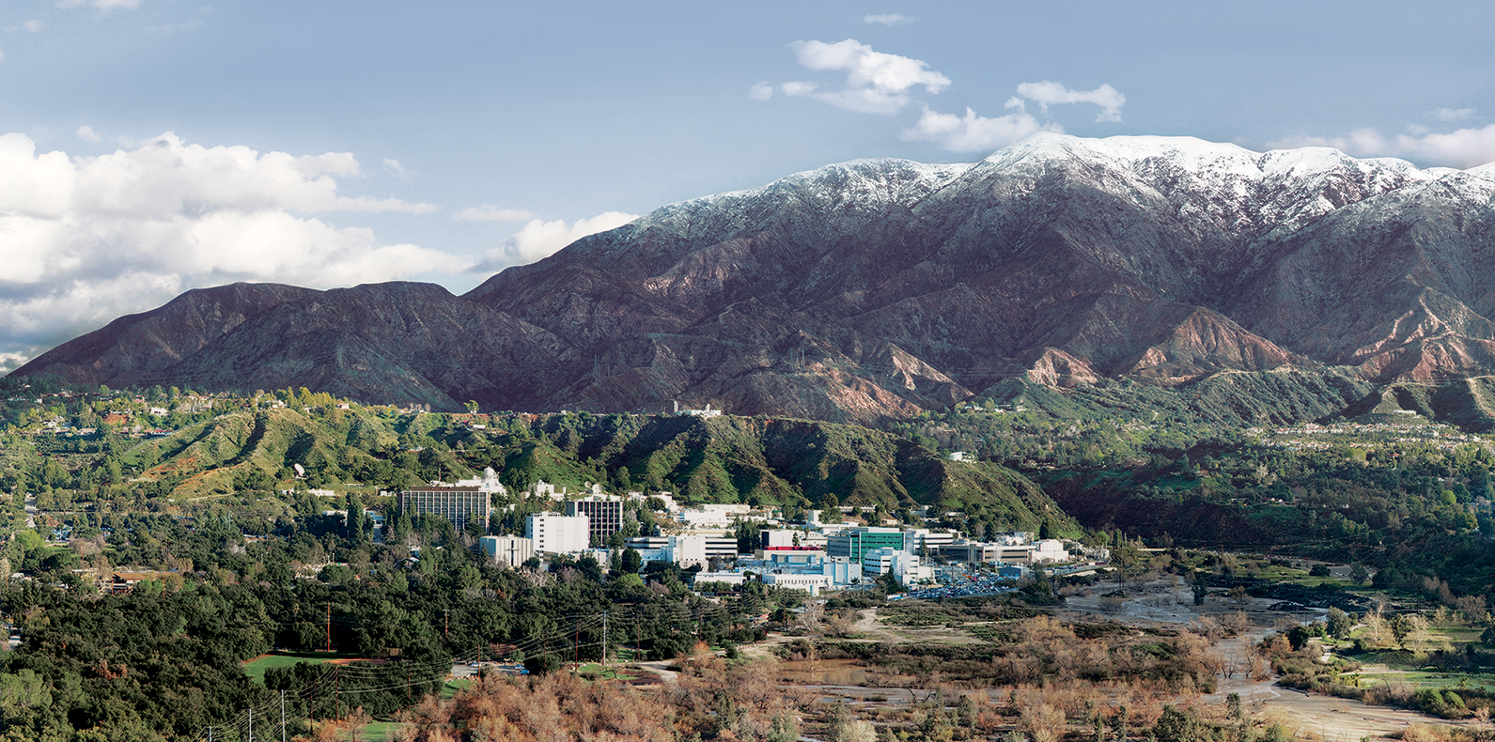
8. Radiances
Dr. David R. Thompson
Jet Propulsion Laboratory, Imaging Spectroscopy Group
July 20, 2019

Slide 2
Goals for this module
Describe factors affecting the physical measurement of radiance spectra
Interpret and apply calibration data to uncalibrated spectral data cubes
Validate radiances in remote field data using in-situ measurements

Slide 3
Reprise
There are three basic types of imaging spectroscopy data in Earth surface studies.
Transforming from raw instrument values to physical units of intensity is the process of calibration.
Later, we’ll describe the process of estimating surface reflectance from radiance data. This second step is atmospheric correction.
After estimating the surface reflectance, one can analyze properties of this spectrum to measure chemical and physical properties of the surface.

Slide 4
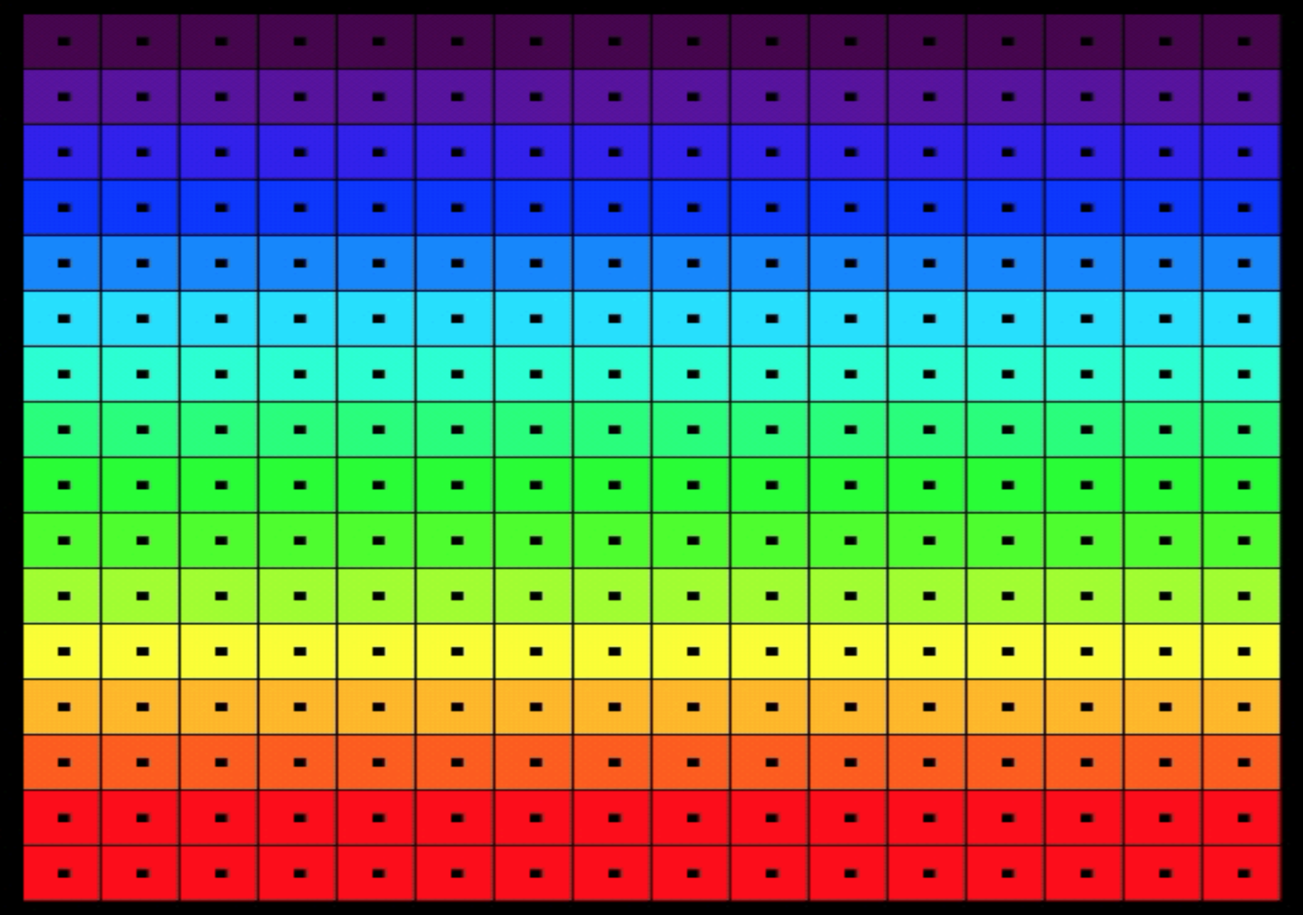
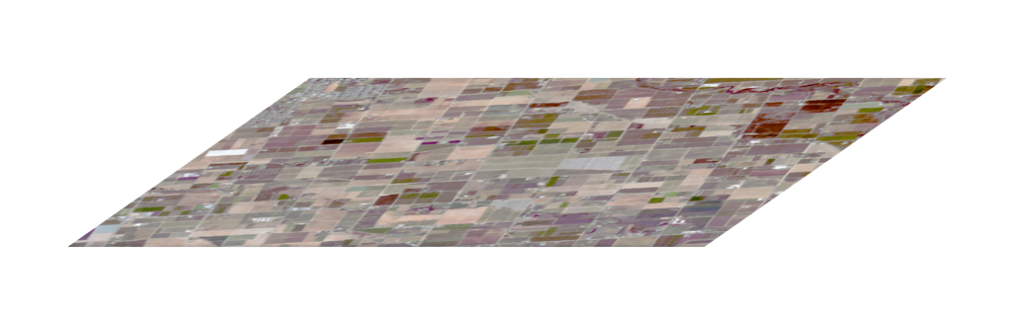
Conventions
The detector is a two-dimensional focal plane array. In a typical “pushbroom” design, one is the spatial dimension and the other is the spectral (wavelength) dimension.
To get the second spatial dimension, we ”push” the sensor on a mobile platform.
FPA
Spectrometer
Slit
Telescope
Rows (spectral channels)
Samples (cross-track locations)

Slide 5
Calibration: basic steps
Typically, calibration involves a series of transformations and corrections that “work backwards from the focal plane”
Account for electronic effects - the unique, time-dependent radiometric response of each FPA element
Account for optical effects - the spatial and spectral “view” of each FPA element
Tie to the S.I. (absolute spectroradiometry)
FPA
Spectrometer
Slit
Telescope

Slide 6
Working backwards from the FPA
Correct dark offset
Account for electronic effects - the unique, time-dependent radiometric response of each FPA element
Account for optical effects - the spatial and spectral “view” of each FPA element
Tie to the S.I. (absolute spectroradiometry)
Correct pedestal shift
Correct panel ghost
Correct flat field
Correct bad pixels
Statistical destriping
Correct crosstrack scatter
Correct spatial scatter
Apply radiometric coefficients

Slide 7
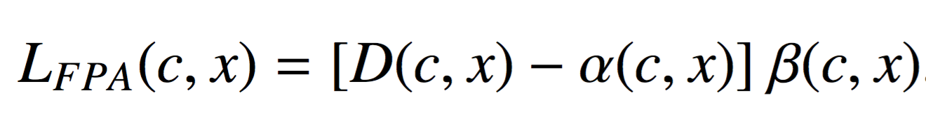
Basic radiometric model
The FPA response is usually linear in illumination. For each crosstrack element x and spectral channel c:
Radiance at FPA
uW nm⁻¹ sr⁻¹ cm⁻²
FPA Value
DN
Offset
DN
Gain
uW nm⁻¹ sr⁻¹ cm⁻² DN⁻¹

Slide 8
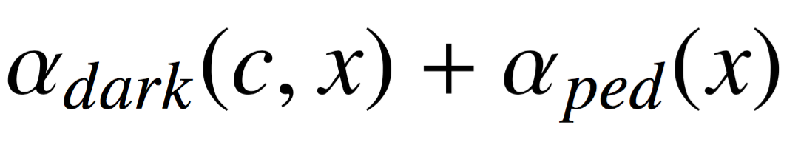
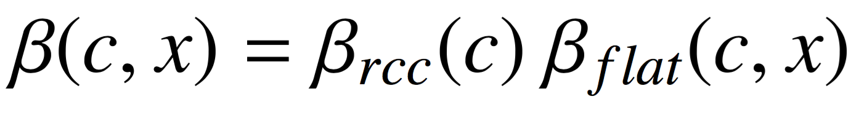
Basic radiometric model
The FPA response is typically linear in illumination. For each crosstrack element x and spectral channel c:
This decomposes into different physical effects:
Offset
DN
Gain
uW nm⁻¹ sr⁻¹ cm⁻² DN⁻¹
Dark Level
(per element, each flightline)
Pedestal shift
(per spectrum, each frame)
Radiometric Coefficient
(per channel, each campaign)
Flat field
(per element, each campaign)

Slide 9
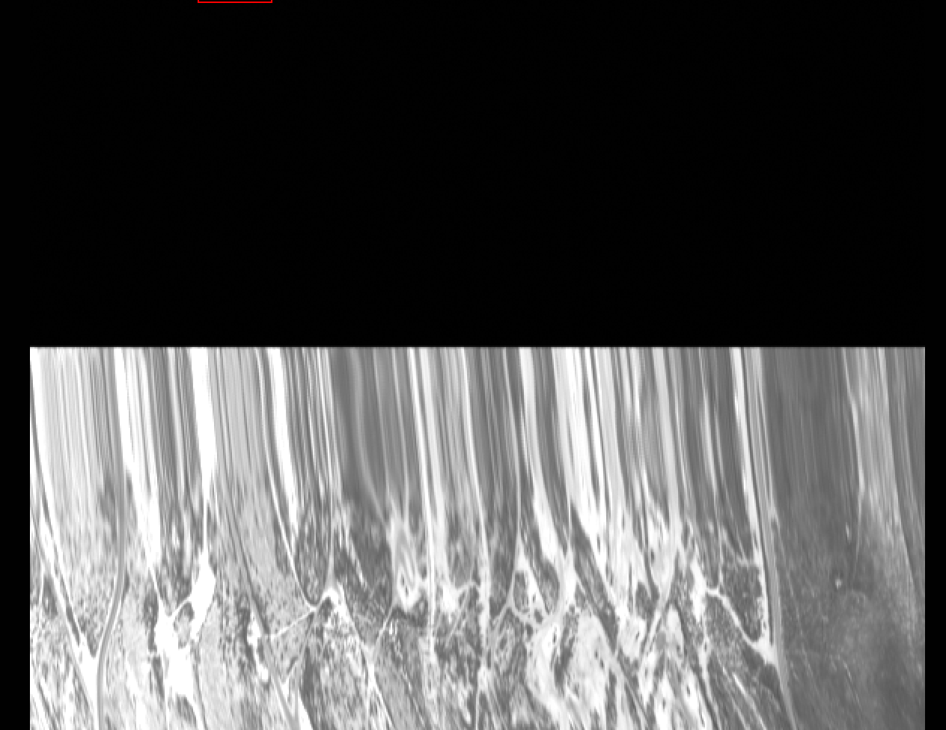
Components of offset
Estimate dark level from initial non-illuminated segment of flightline
The “offset” term typically includes a bias due to dark current, estimated from “closed shutter” data.
Other electronic effects (here, a “Pedestal shift”) can create systematic positives or negative biases. Each has its own estimation method.
Estimate pedestal shift from non-illuminated channels

Slide 10
Components of gain
Estimate RCCs using a NIST-calibrated source
Gain is typically separated into two components. A flat field represents the relative response of all elements on the focal plane array. It serves to make their response uniform. Values are typically close to unity.
After this spatial normalization, Radiometric Coefficients (RCCs) map the normalized, offset-subtracted instrument Digital Numbers (DN) to physical radiance units.
Estimate flat field from a uniform sphere passed across the FOV

Slide 11
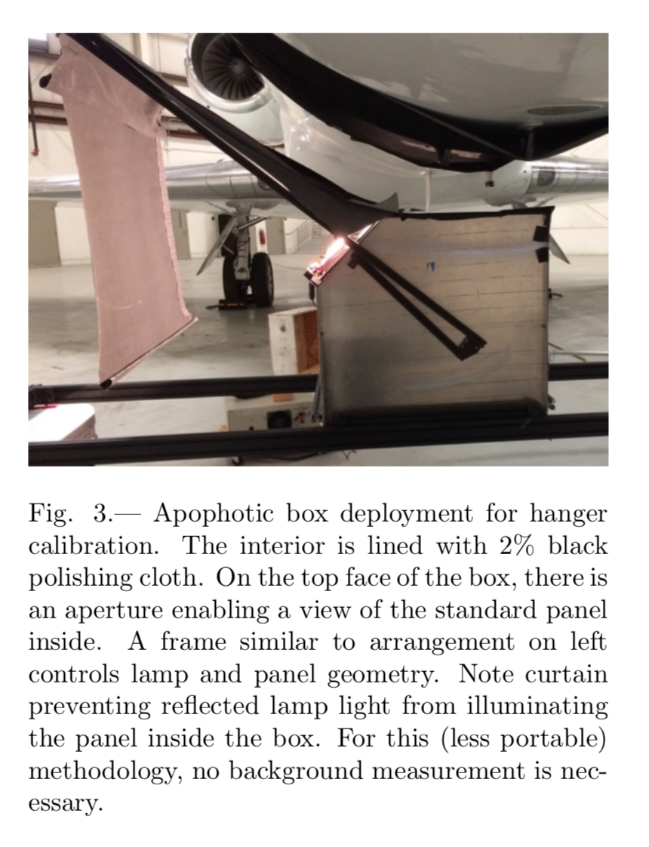
Estimate RCCs using a NIST-calibrated source
A dark laboratory, or special enclosure, prevents external light from entering.
Chapman et al., Remote Sensing (2019)

Slide 12
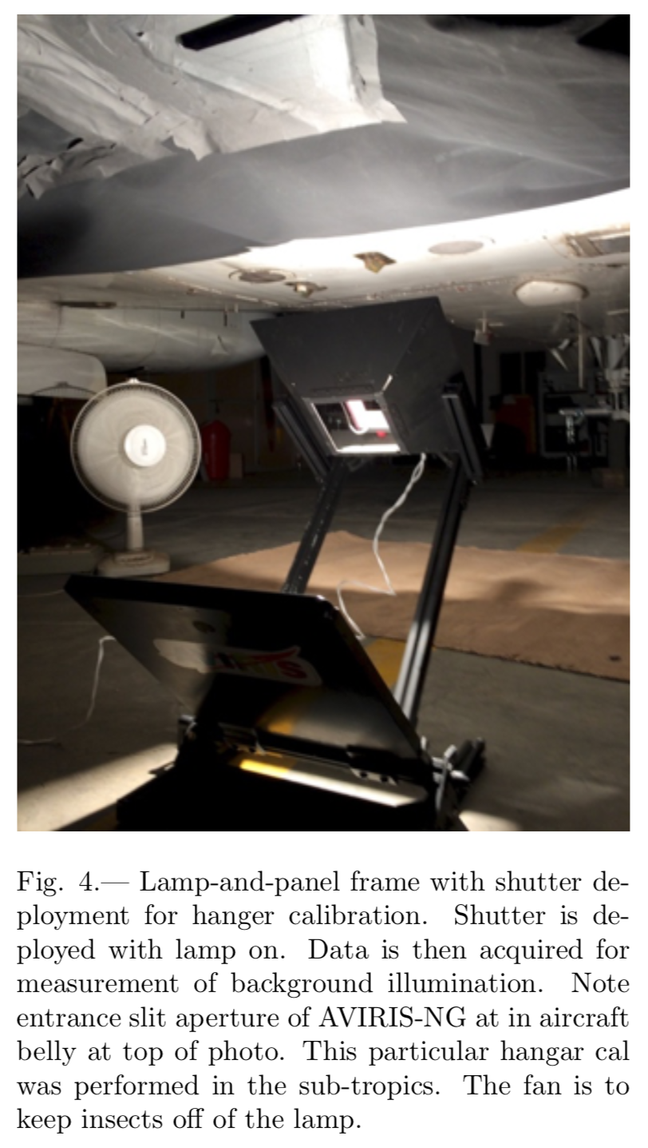
Estimate RCCs using a NIST-calibrated source
Field calibration, with the instrument installed on the aircraft, is also possible but requires special care.
Chapman et al., Remote Sensing (2019)

Slide 13
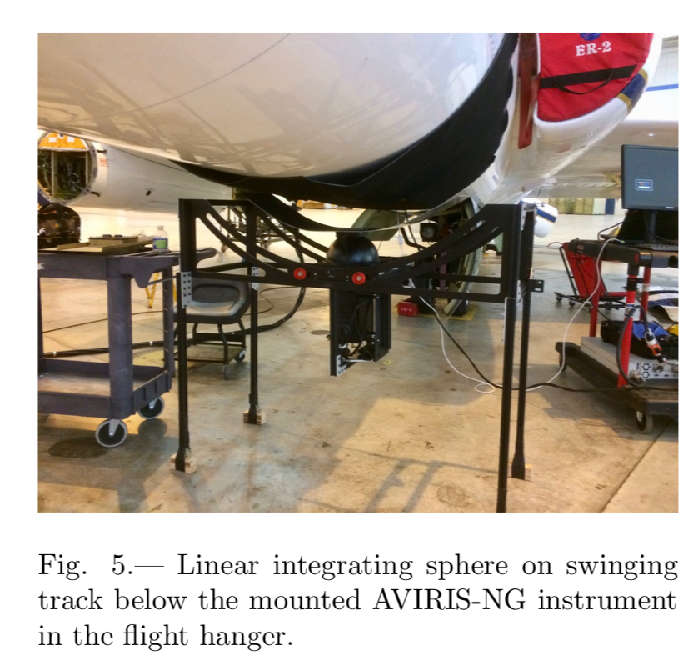
Flat field calibration equipment
Measuring the flat field response image requires a completely uniform illumination from a specially-designed calibration object (here, a hollow ball illuminated from the inside, known as an integrating sphere). Each spectral channel’s response is scaled so that the flat field rows all average to unity.
Chapman et al., Remote Sensing (2019)

Slide 14
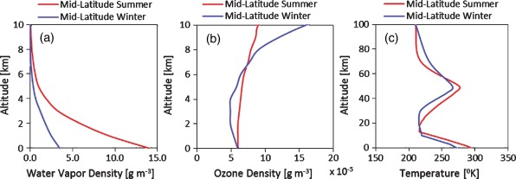
Validation method
We validate flight data by measuring a reflectance signature on the ground, and then converting it to reflectance with a Radiative Transfer Model (RTM) that simulates photon propagation through the atmosphere.
RTM
scattering
absorption
images: Mishra et al., Heliyon 2015, wikimedia
reflection

Slide 15
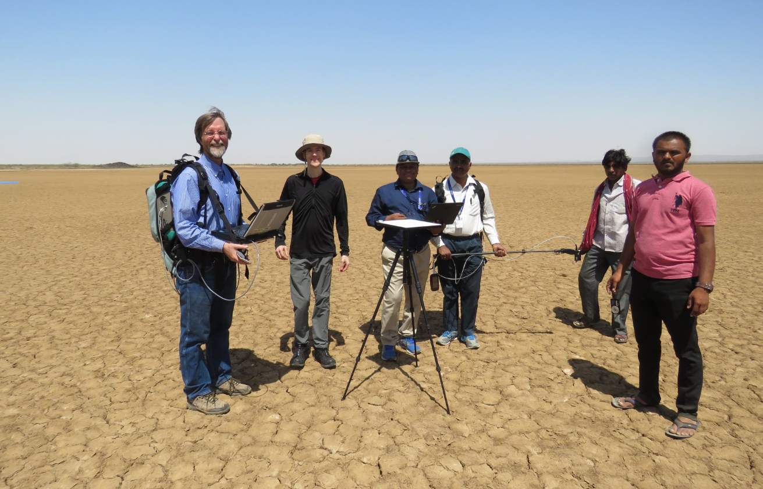
Validation
Field reflectance measurements are typically performed at an open playa site to limit scattered light from local vegetation or buildings. The surface should be uniform and flat, and imaged simultaneously with the overflight for similar solar geometry.
AVIRIS-NG remote measurement
AVIRIS-NG
Model from In-situ measurement
MODTRAN simulation
Desalpar Playa, India
Residual

Slide 16
Other artifacts
A variety of artifacts appear in imaging spectrometer data due to electronic and optical effects on different timescales. Interested? Check out the explanatory paper by Chapman et al., Remote Sensing, 2019.
Optical effects
Detector and alignment
Whole FPA
NIST radiometry
SRF correction
Electronic and thermal effects
FPA sub-region
Atmospheric wavelength tuning
Laboratory wavelength calibration
Panel Ghost
“Bad element” replacement
Markov destriping
Flat field
FPA element
Pedestal shift
Dark offset
milliseconds
minutes
months
years

Slide 18
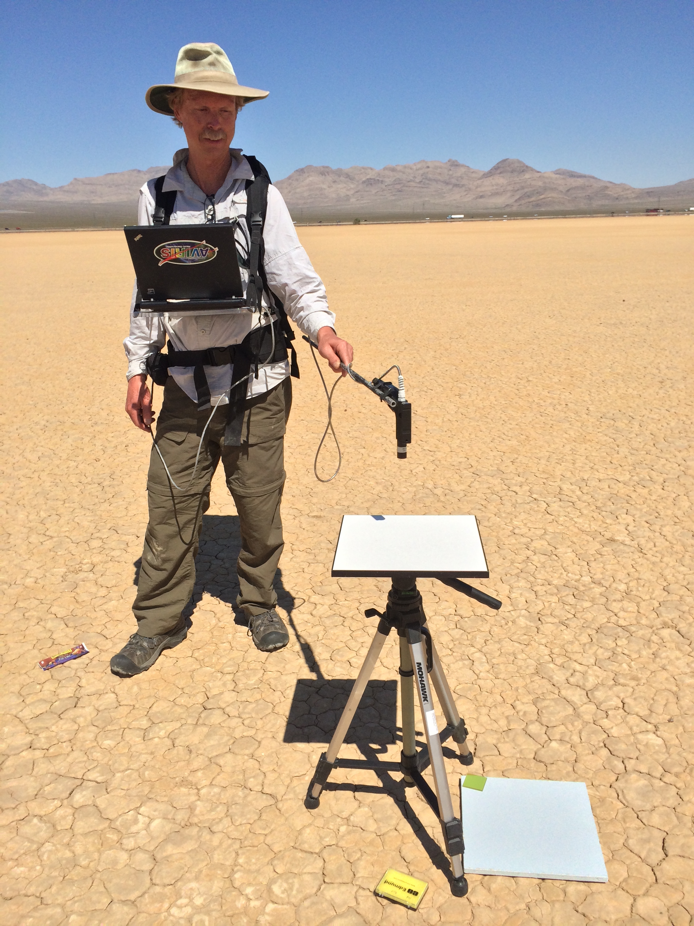
Exercise 7: Radiometric Calibration / Validation
Objective: Calibrate digital numbers and “close the loop” with predicted radiances from surface measurements acquired coincidently with an overflight of Ivanpah Playa, NM. Compare alternative Radiative Transfer Models (RTMs). Which is best? Files include:
predicted_radiance_atrem - a prediction of at-sensor radiance following Thompson et al., (RSE 2015).
predicted_radiance_modtran - via the MODTRAN RTM
flat - a flat field frame
rcc.txt - a file of radiometric calibration coefficients
dark - a dark current frame
dn - an imaging spectrometer file containing raw spectrometer data
loc - 3 bands, latitude, longitude, altitude, of the non-orthorectified FN file.
Reflectance was measured between two blue tarps placed on the playa surface, and used in the radiative transfer model. South tarp: 35.60285N, 115.40388W. North tarp: 35.60466, -115.40266

